Slide 1
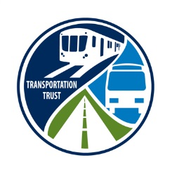
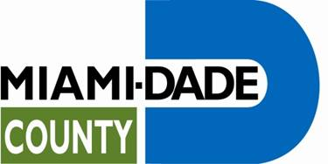
Florida International University
XIX Inter-American Conference of Mayors and Local Authorities
Citizen Oversight as a Critical Tool in the Approval and Administration of New Funding Sources for Transportation and Government Programs
Charles Scurr
June 18, 2013

Slide 2


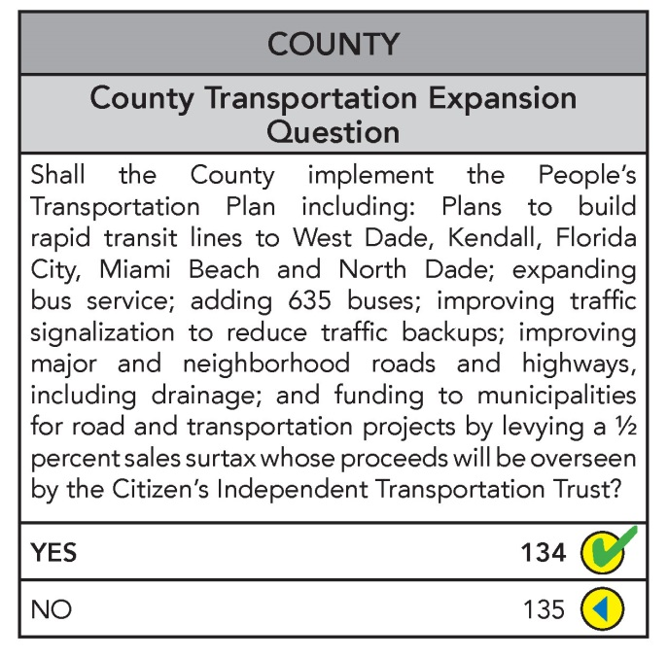
Overview of the Transportation Trust
On November 5, 2002, Miami-Dade County voters approved a half-penny surtax to implement the People’s Transportation Plan (PTP)
The People’s Transportation Plan (PTP) is a broad based and long term program incorporating roadway and transit improvements
Voters also approved the creation of a Citizens’ Independent Transportation Trust (Transportation Trust), an independent organization comprised of citizens who serve as volunteers with the mission to oversee expenditure of surtax revenue
Mission Statement: To provide the Citizens’ Independent Transportation Trust (CITT) with professional administrative staff support to fulfill its statutory requirements to monitor, audit, oversee and investigate the use of the Surtax proceeds and the implementation of the People’s Transportation Plan (PTP).

Slide 3

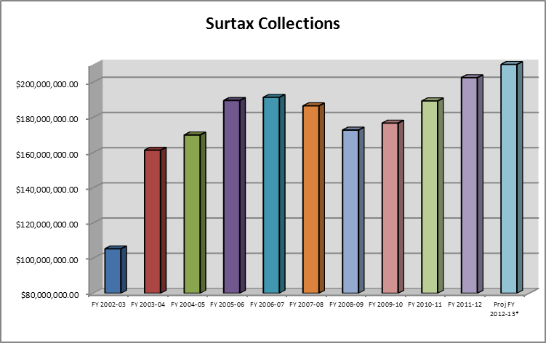
Transportation Trust Oversight and Administration

Slide 4
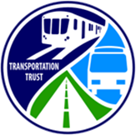

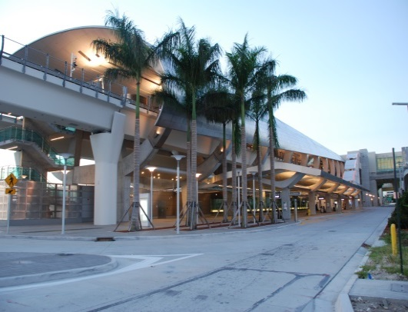
Metrorail - The Orange Line
  Completion of the Metrorail Orange Line to Miami International Airport
    2.4 miles
    $506 million ($405 million in PTP Funding; $101 million FDOT)
  Construction started in May 2009 and was completed July 2012, on budget and on time

Slide 5


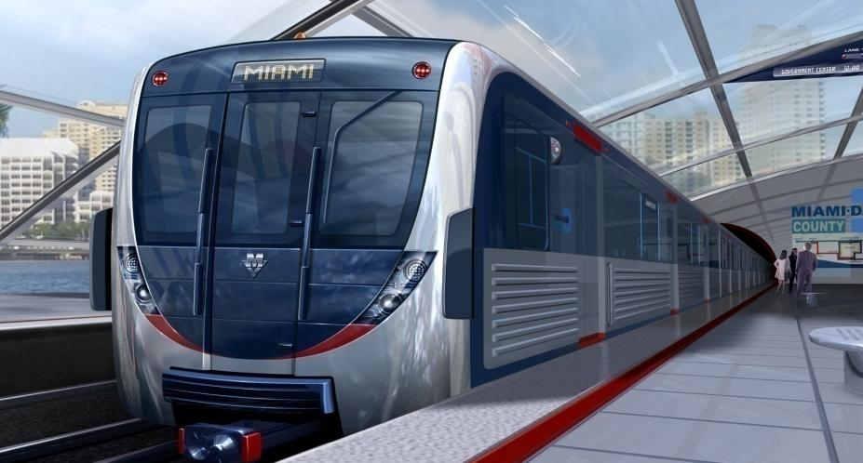
Metrorail – New Railcars
Record Ridership – 1.9 million Metrorail passengers in March
$375 million in Surtax funding was approved for the purchase a new state-of-the-art Metrorail fleet: Delivery starting in 2015
The new Metrorail vehicles will be equipped with the latest technology that will offer transit customers improved reliability and customer service
Rendering of the New Metrorail Vehicles
Notes:
This rendering of the new Metrorail vehicles was used as the logo for today’s Summit and the contractor, AnsaldoBreda, has an exhibit in the Summit Marketplace

Slide 6

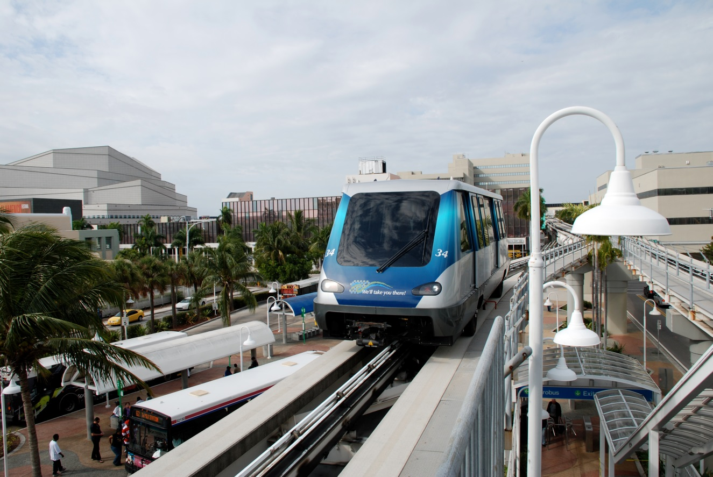
Metromover
Annual ridership on Metromover is approximately 9 million riders per year; double what it was before the PTP was passed
Surtax funds were used to purchase 29 new Metromover vehicles at a cost of $69 million
Metromover fares were eliminated after passage of the PTP improving customer convenience and streamlining operations.
Workers and visitors in the downtown area enjoy an improved commute on board the sleek new Metromover vehicles that go just about anywhere in the Downtown Miami, Brickell or Omni area
New Metromover Vehicle

Slide 7

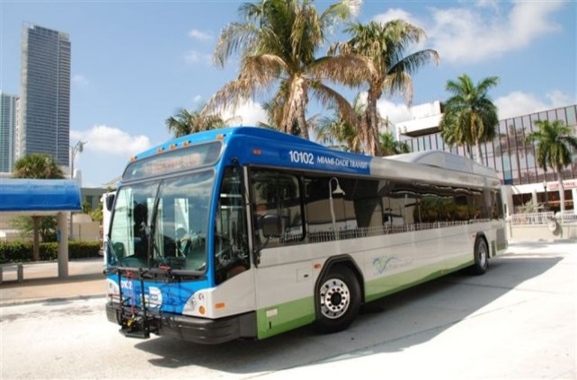
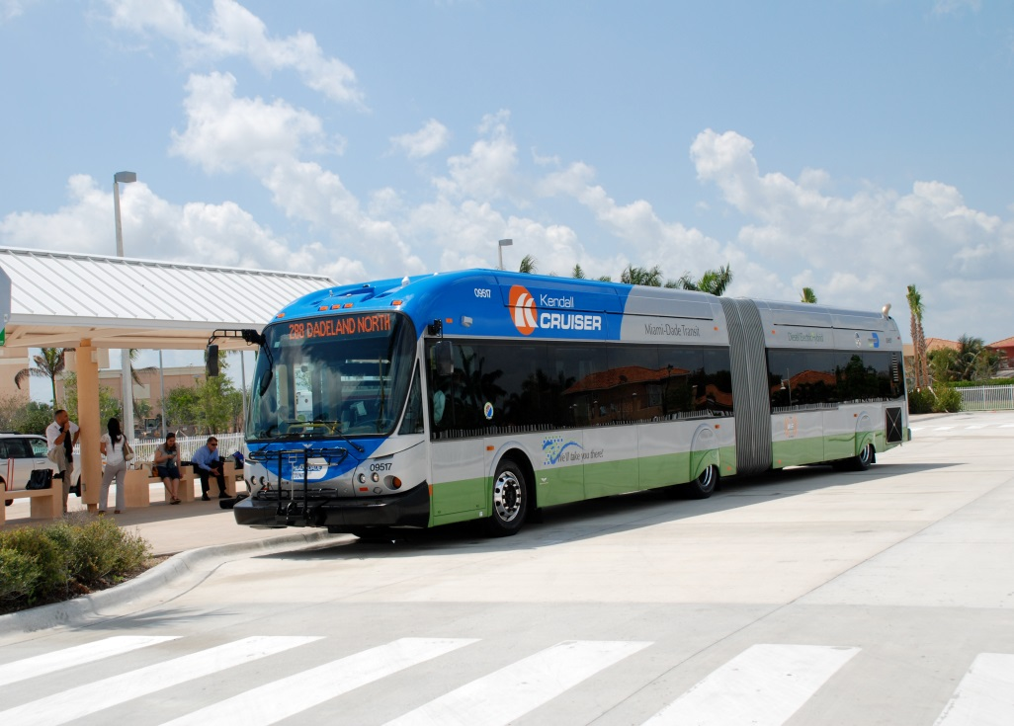
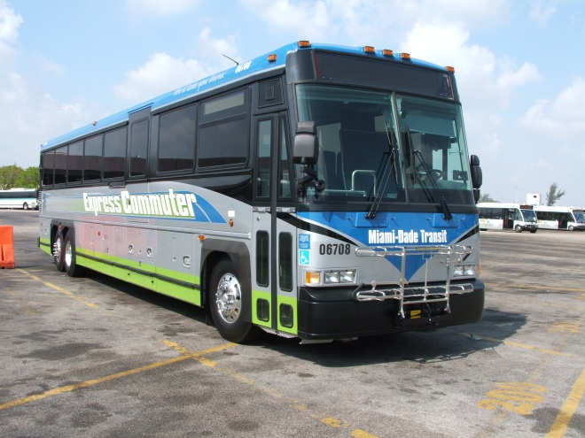
Metrobus
PTP funds added 596 new buses to the Metrobus fleet at using $135 million Surtax funds
New bus purchases include 60-foot articulated buses, minibuses, 40-foot buses low-floor buses and over-the-road commuter coaches
60-Foot Articulated Diesel Electric Hybrid Bus
40-Foot Diesel Electric Hybrid Low Floor Bus
Commuter Coach

Slide 8


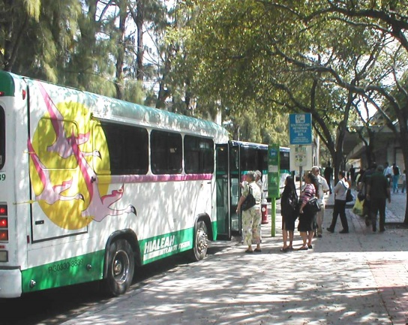
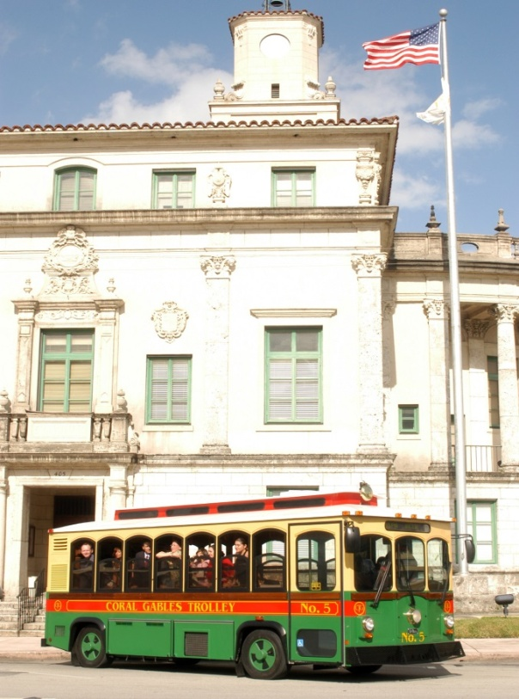
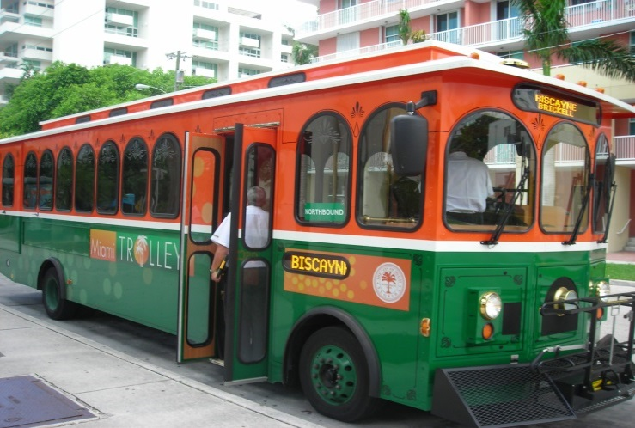
Municipal Transportation Program
23% of Surtax funds are allocated to Miami-Dade County municipalities for transit and roadway improvements.
The 34 participating municipalities receive about $46 million dollars annually in Surtax funds.
Hialeah Transit Service
Coral Gables Trolley
City of Miami Trolley

Slide 9

Citizen Oversight as a Critical Tool in the Approval and Administration of New Funding Sources for Transportation and Government Programs

Slide 10

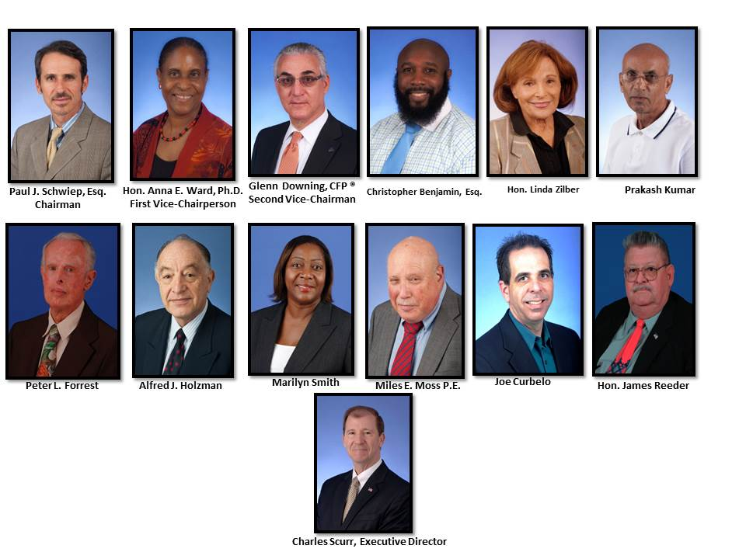
Transportation Trust Oversight and Administration

Slide 11

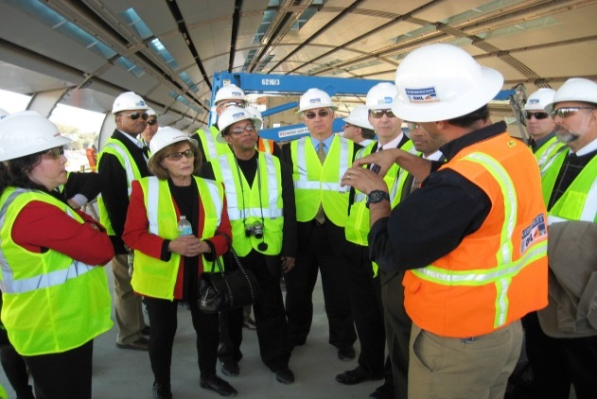
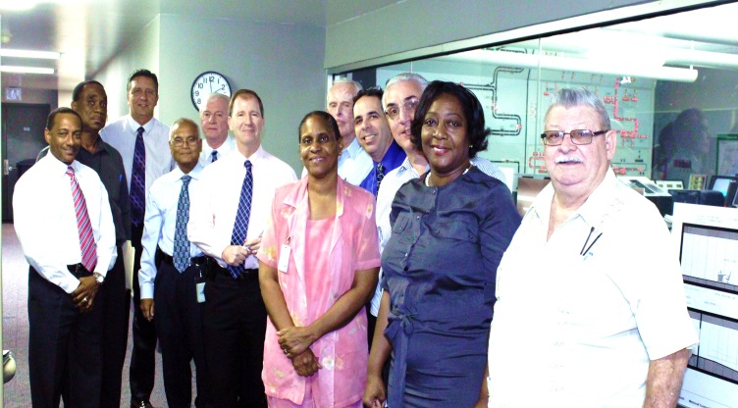
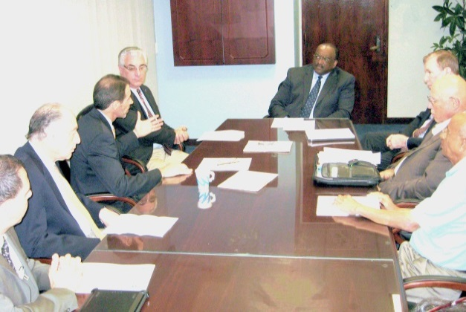
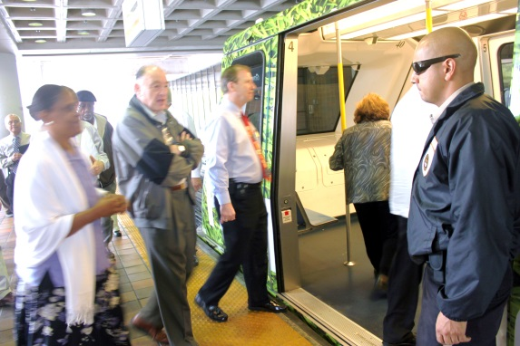
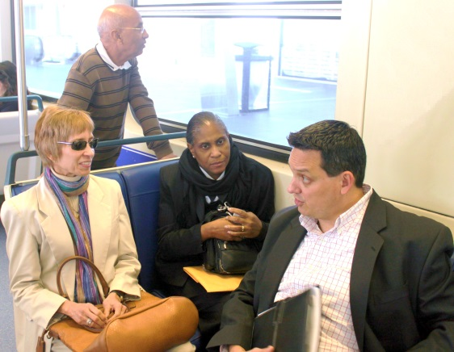
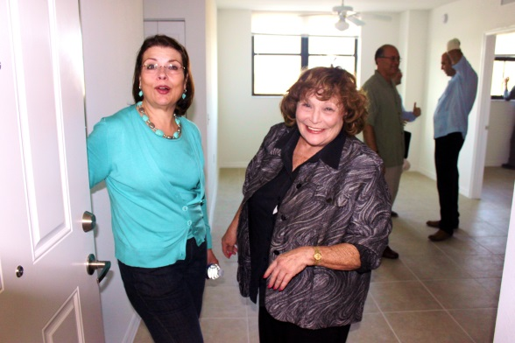
10 Years of Progress
Transportation Trust Oversight and Administration
The Transportation Trust continues to have an essential role and mission in the financing, oversight and improvement of public transit and transportation in Miami-Dade County
Oversight Visit During Construction of the Orange Line
Trust Members at Metrorail/Metromover Central Control
Trust Members Discuss Transportation Issues With Hon. Dennis Moss
Hon. Linda Zilber and MDT Director Ysela Llort Look at an Affordable Housing Unit at Brownsville Transit Village
Oversight Visit of Metrorail Operations Center
Trust Members Board Metromover

Slide 12
Citizen Oversight as a Critical Tool in the Approval and Administration of New Funding Sources for Transportation and Government Programs
Bond Issue: Safe Neighborhood Parks Bond Program
Election Date: November 5, 1996
Ordinance Language: ordinance authorizing issuance, subject to approval by special election, of not exceeding $200,000,000 general obligation bonds of Dade county, Florida for purpose of financing capital improvement program for certain parks, beaches, natural areas and recreation facilities; establishing a citizens' oversight committee, including membership and powers to administer program; designating entities and projects eligible for funding; providing severability, inclusion in the code, and effective date.

Slide 13
Citizen Oversight as a Critical Tool in the Approval and Administration of New Funding Sources for Transportation and Government Programs
Bond Issue: Building Better Communities
Election Date: November 2, 2004
Ordinance Language: ordinance authorizing issuance, subject to approval by special election, of not exceeding ($2,547,567,000) general obligation bonds of Dade county, Florida to promote public safety by constructing and improving detention centers, justice centers, courthouses, police, fire and lifeguard stations, and new animal care and control facilities, capital improvement program for certain parks, beaches, natural areas and recreation facilities (etc.); establishing a citizens' oversight committee, including membership and powers to administer program; designating entities and projects eligible for funding; providing severability, inclusion in the code, and effective date.

Slide 14
Citizen Oversight as a Critical Tool in the Approval and Administration of New Funding Sources for Transportation and Government Programs
Bond Issue: The Children’s Trust
Ballot Language: County Question No. 13
Charter Amendment: Children’s Trust for Children’s Health, Safety and Development
Shall the Charter be amended to name the Independent Special District for Children’s Services “The Children’s Trust” with authority to:
• fund improvements to children’s health, development and safety;
• promote parental and community responsibility for children;
• levy an annual ad valorem tax not to exceed one-half (1/2) mill to supplement current County expenditures for children services (this levy requires voter renewal in 2008); and
• have membership provided in state law for home rule charter counties?

Slide 15
Citizen Oversight as a Critical Tool in the Approval and Administration of New Funding Sources for Transportation and Government Programs

Slide 16
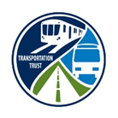

The Question:
Is Citizen Oversight an essential and critical tool in the approval and administration of new funding sources for transportation and government programs?
The Answer:
Yes. Citizens’ oversight will not only help win voter approval but it will positively add to the administration of the programs.

Slide 17
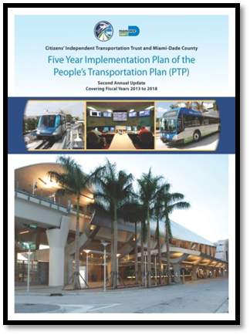
The Transportation Trust
Useful Links
Transportation Trust Home Page
www.miamidade.gov/citt
PTP 5-Year Implementation Plan
http://www.miamidade.gov/citt/PTP_5_year_plan.asp
Strategic Planning Studies
http://www.miamidade.gov/citt/strategic-financial-studies.asp

