Slide 1
Creating a model city in the face of climate change and impending sea level rise (and failure of higher levels of government to take serious action on the coming disaster)
Philip K Stoddard, PhD
Mayor, City of South Miami
Professor, Florida International University
“The reasonable man adapts himself to the world; the unreasonable one persists in trying to adapt the world to himself. Therefore, all progress depends on the unreasonable man.”
George Bernard Shaw

Slide 2
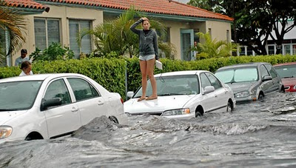
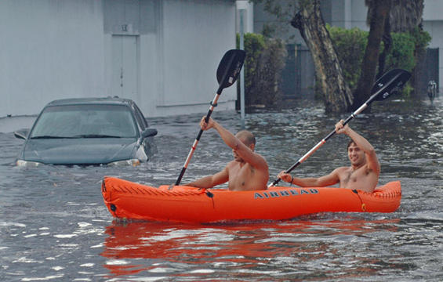
Miami Herald, 2009
“just a drainage problem”
Miami Beach, 2009
Notes:
Photo taken in Miami Beach, June 2009, Miami Herald

Slide 3
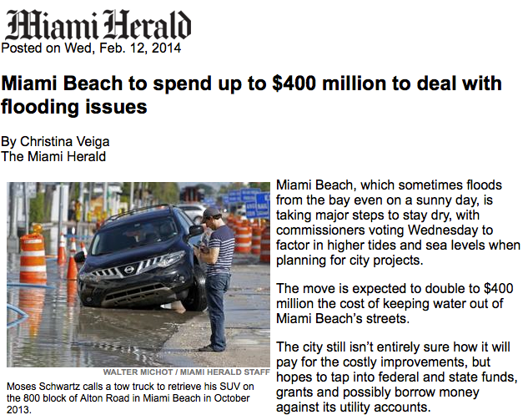
5 YEARS LATER
"Americans can always be counted on to do the right thing...
after they have exhausted all other possibilities.” Winston Churchill

Slide 4
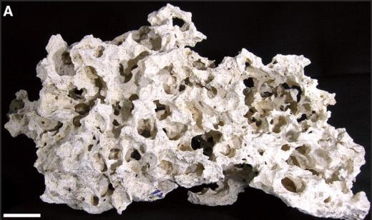
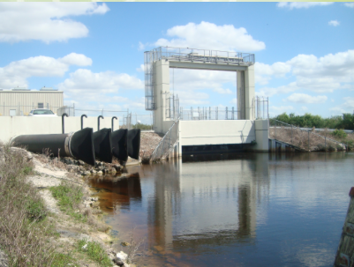
Water flows 130 meters / hour through the porous limestone under Miami.
Dikes and levees cannot hold out
saltwater, only
natural freshwater
flow can do that.

Slide 5
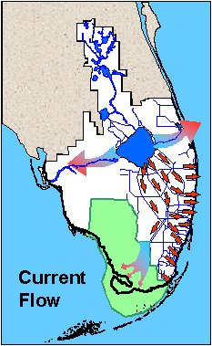
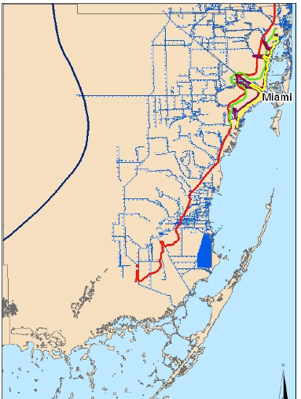
Human-altered water flow
Saltwater Intrusion 2011

Slide 6
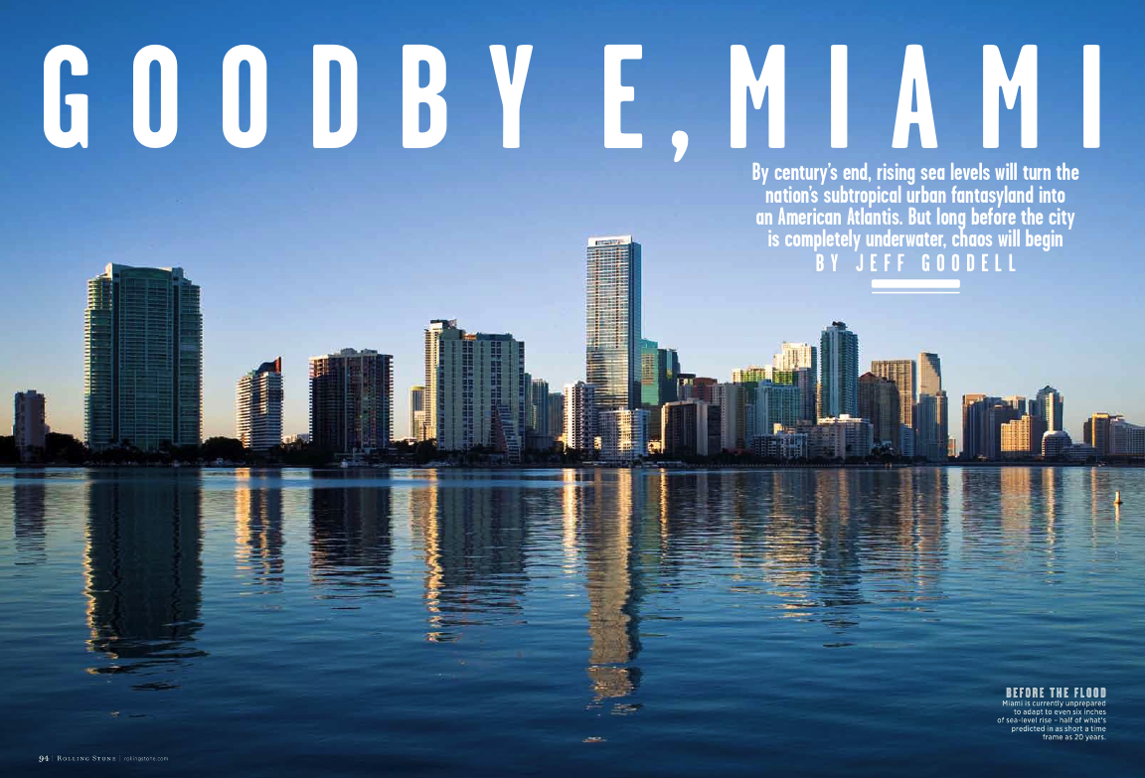

Slide 7
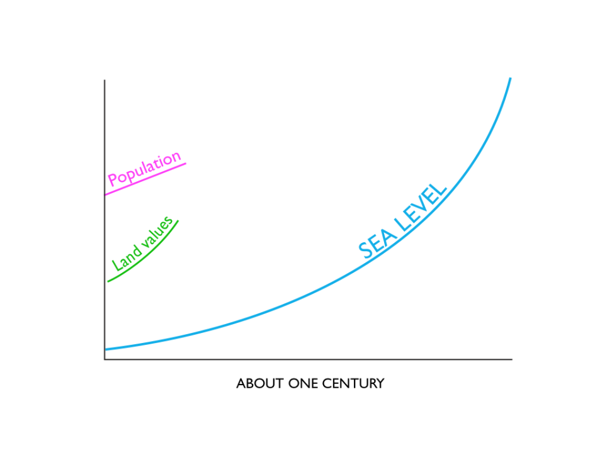
PHIL’S MODEL
now

Slide 8
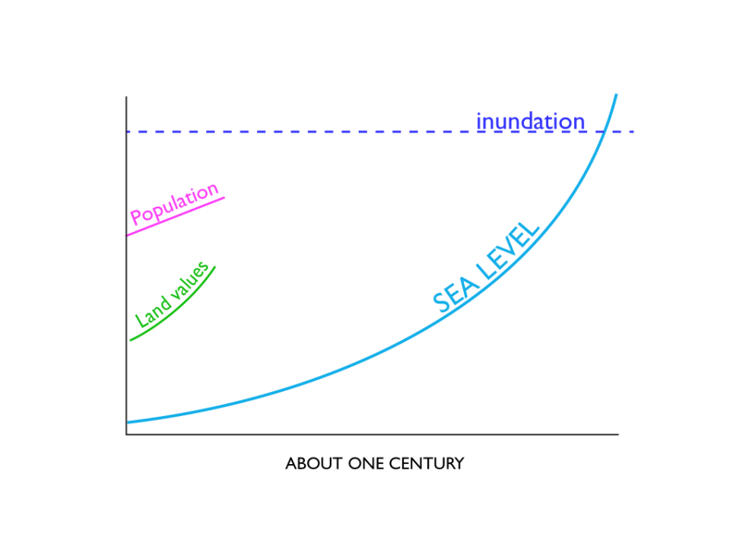

Slide 9
sewers fail
drainage pumps fail
saltwater fills Biscayne aquifer
50 cm
20 cm

Slide 10
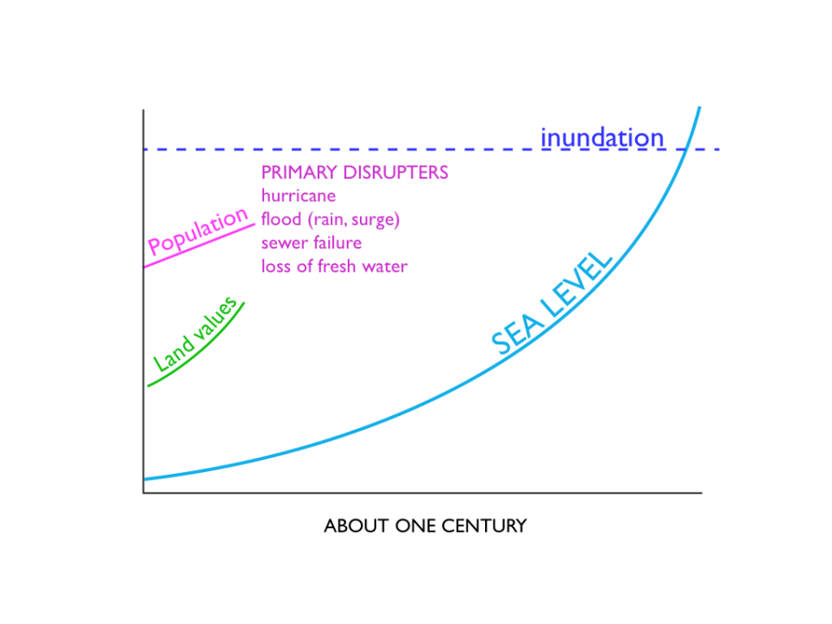
sewers fail
drainage pumps fail
saltwater fills Biscayne aquifer
50 cm
20 cm

Slide 11
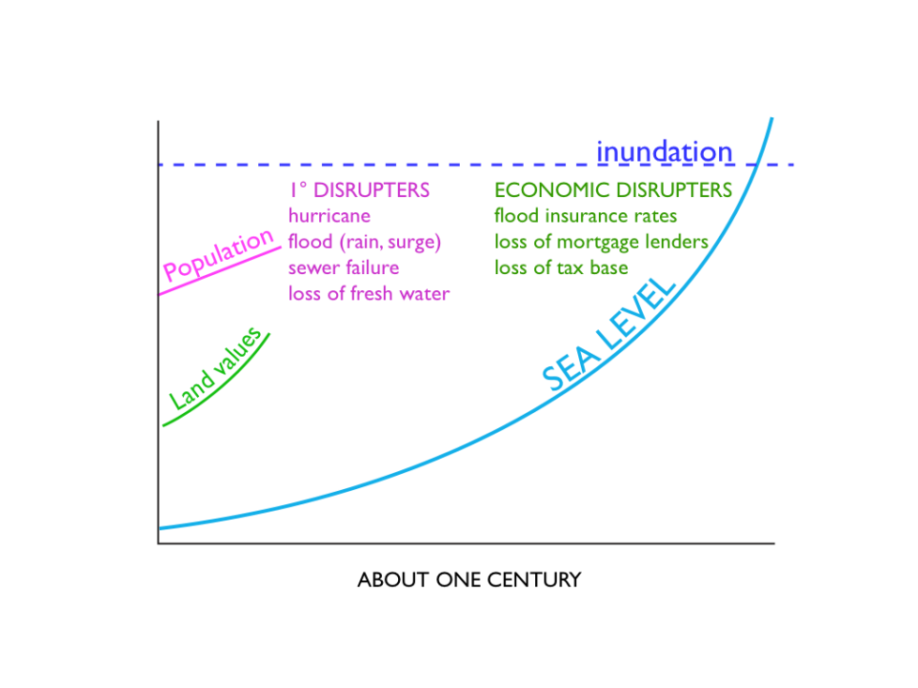
sewers fail
drainage pumps fail
saltwater fills Biscayne aquifer
50 cm
20 cm

Slide 12
sewers fail
drainage pumps fail
saltwater fills Biscayne aquifer
50 cm
20 cm

Slide 13
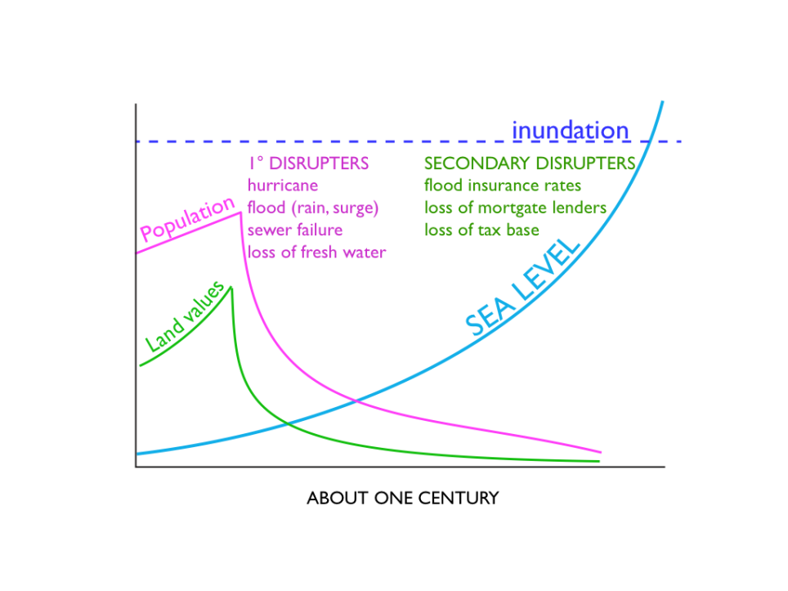

Slide 14
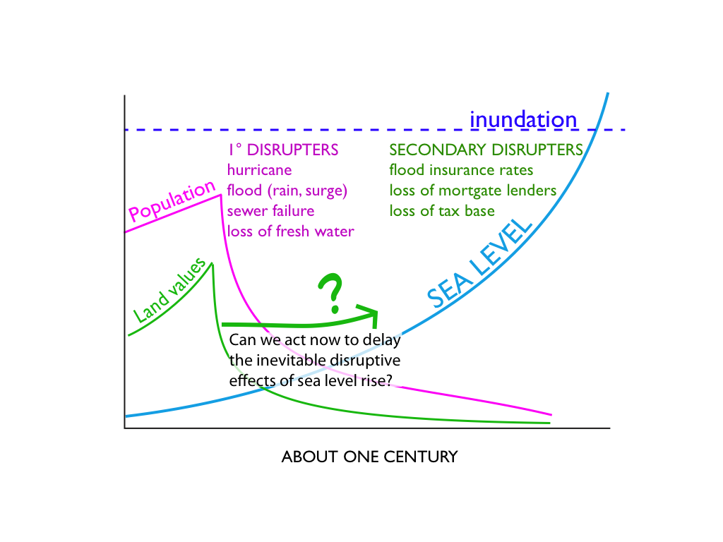

Slide 15
What would we do if we were smart?
Fix water flow and drainage.
Avoid building in lowest areas.
Stop subsidizing construction in flood zones.
Discourage investment in low areas.
Protect essential infrastructure.
Save money for demolition & relocation.
Carbon reduction policy.
Green building codes.

Slide 16
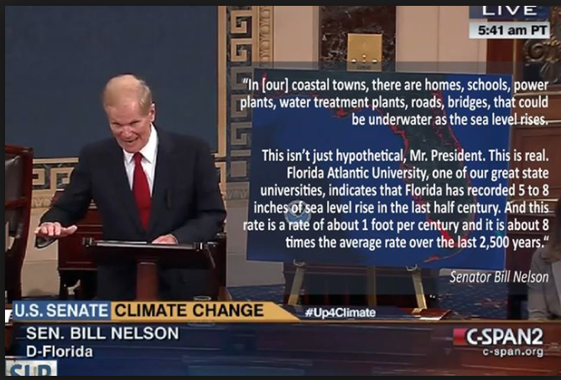

Slide 17
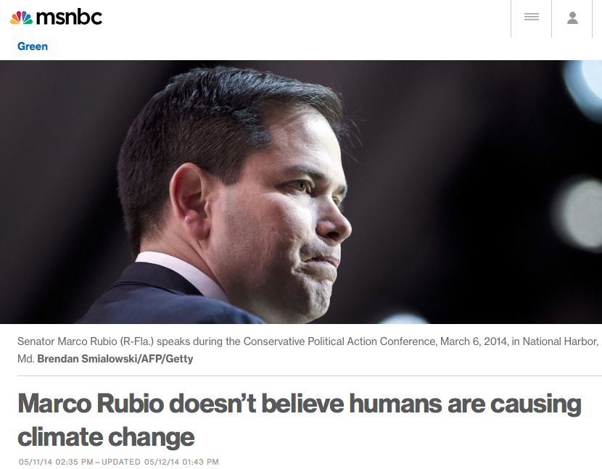

Slide 18
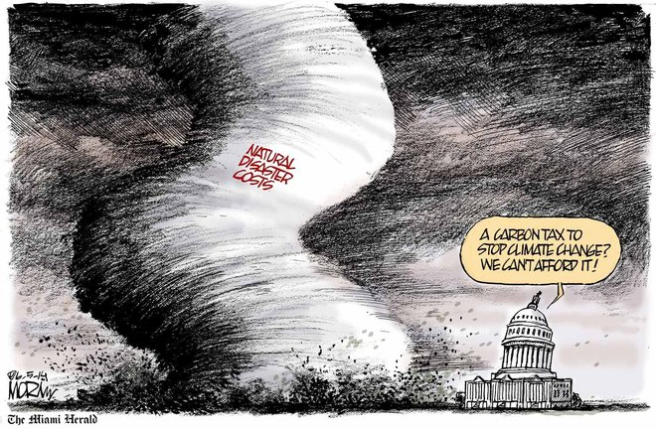

Slide 19
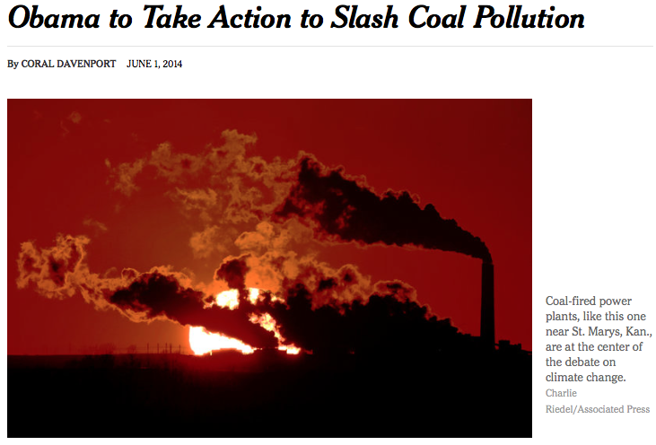

Slide 20
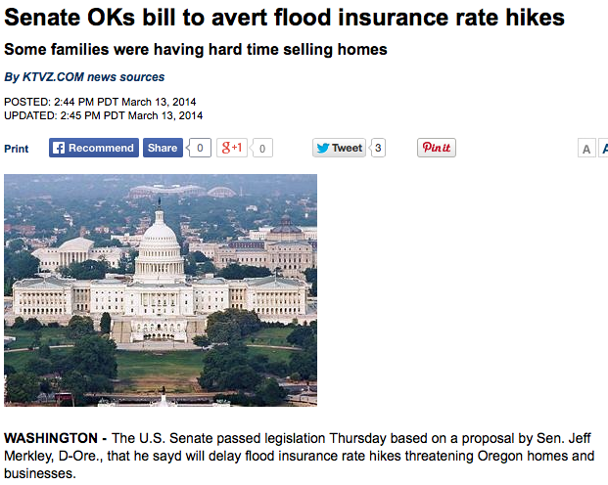

Slide 21
U.S. insurer class action may signal wave of climate-change suits
Fri, May 16 2014 By Mica Rosenberg
(Reuters) - A major insurance company is accusing dozens of localities in Illinois of failing to prepare for severe rains and flooding in lawsuits that are the first in what could be a wave of litigation over who should be liable for the possible costs of climate change.
Farmers Insurance filed nine class actions last month against nearly 200 communities in the Chicago area. It is arguing that local governments should have known rising global temperatures would lead to heavier rains and did not do enough to fortify their sewers and stormwater drains.
The legal debate may center on whether an uptick in natural disasters is foreseeable or an "act of God." The cases raise the question of how city governments should manage their budgets before costly emergencies occur.

Slide 22
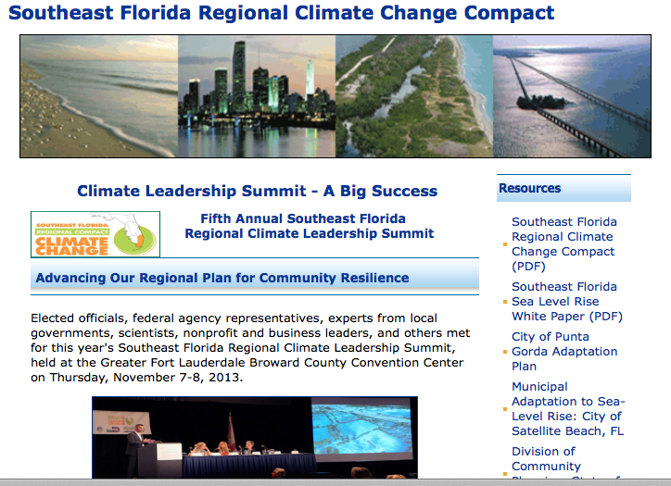

Slide 23
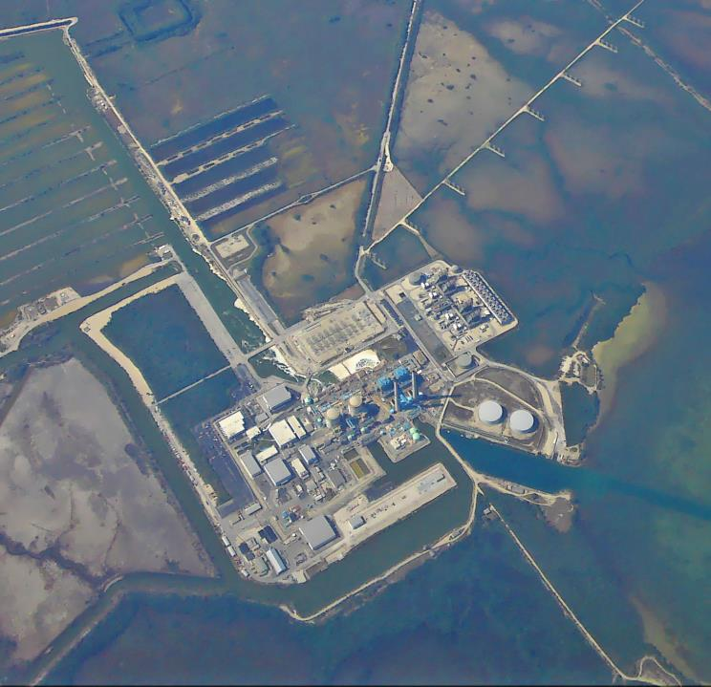
Turkey Point
25 km south
of Miami
is the
worst place
for nuclear
reactors
in the USA

Slide 24
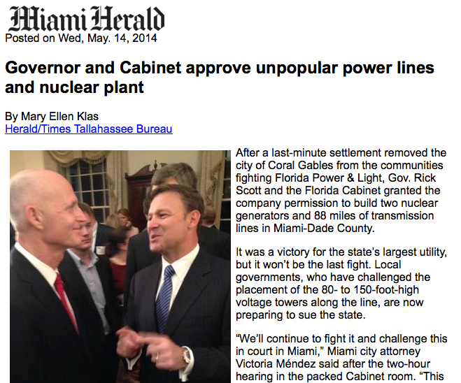

Slide 25
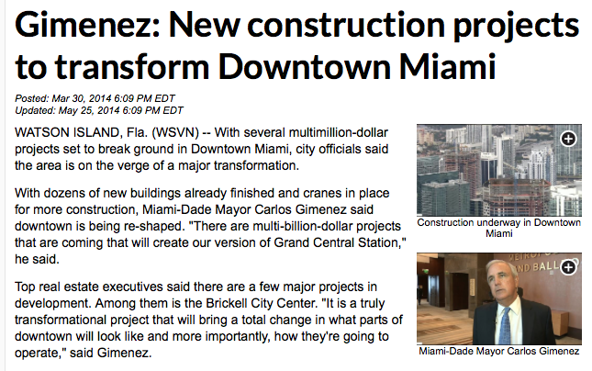
“The first rule of holes: when you find yourself in one, stop digging.”
Molly Ivins

Slide 26
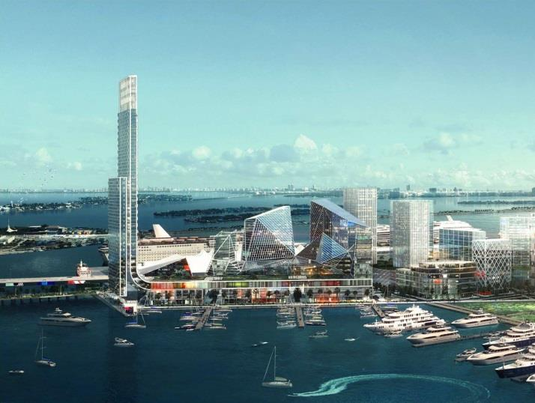
PortMiami
By exMiami Staff on March 10, 2014
PortMiami and World Trade Center officials have been in Asia seeking funding for a plan to build a proposed 4.8 million square foot World Trade Center at PortMiami… The plan conflicts with a more recent proposal by David Beckham for a soccer stadium at the site.
Notes:
“The first rule of holes: when you find yourself in one, stop digging.” Molly Ivins

Slide 27
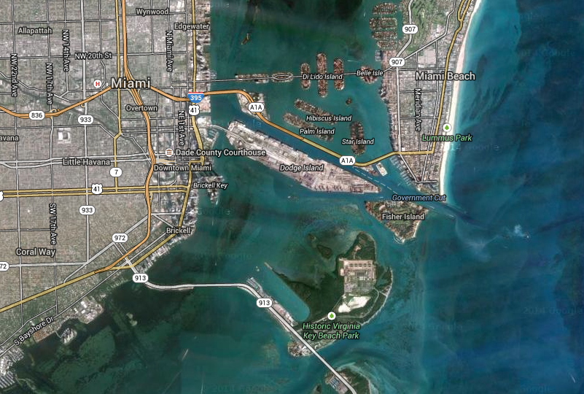
Miami-Dade
County
Central
Sewage
Plant

Slide 28
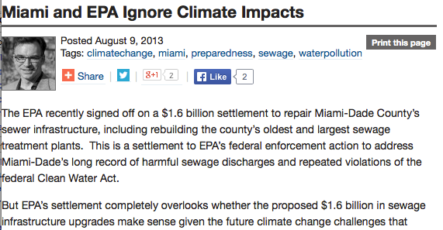

Slide 29
What would we do if we were smart?
Fix water flow and drainage. starting late
Avoid building in lowest areas. ✗
Stop subsidizing construction in flood zones. ✗
Discourage investment in low areas. ✗
Protect essential infrastructure. ✗
Save money for demolition & relocation. ✗
Carbon reduction policy. just starting
Green building codes. ✗
Big failures at federal, state, and county levels.
Can a municipality do any better?

Slide 30
What can a small municipality do?
Fix our drainage before it fails.
Green building codes.
Urban design to get people out of their cars.
Promote clean energy.
Save money for demolition & relocation.

Slide 31
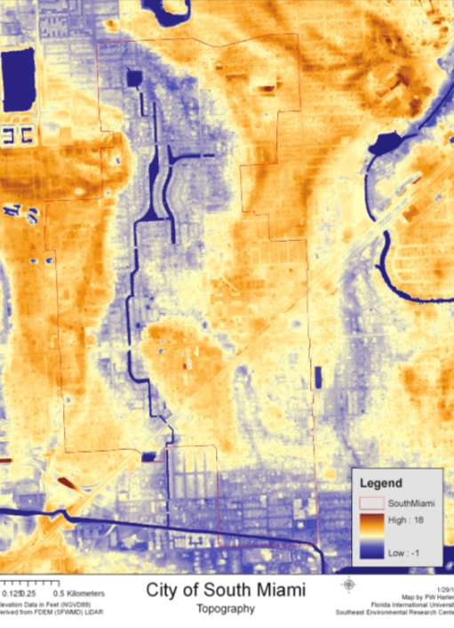

Slide 32
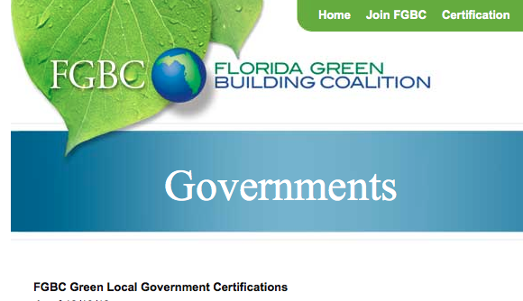
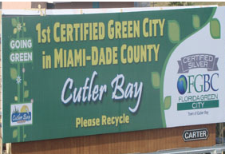

Slide 33
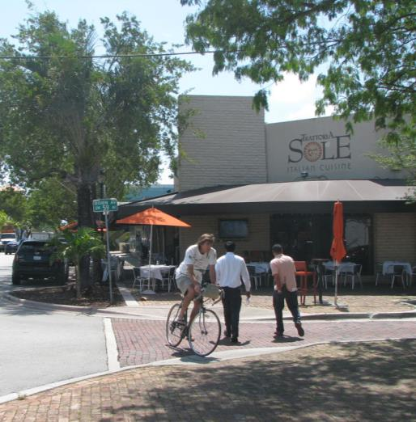
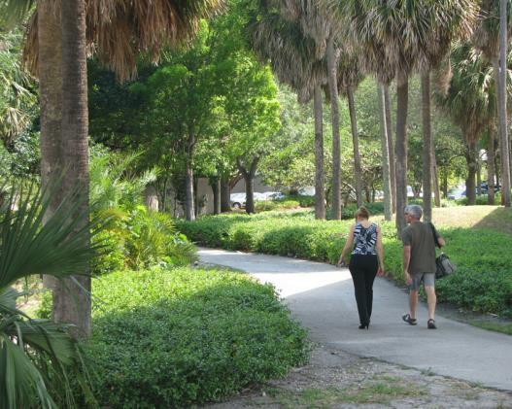
Reduce auto transportation
by making cities beautiful places
for walking and biking

Slide 34
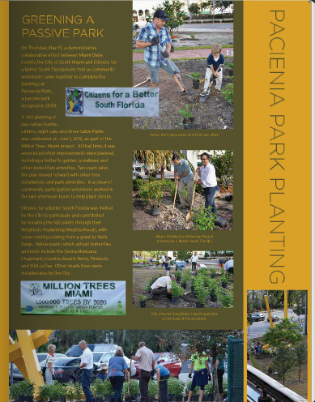
PLANT A LOT OF TREES

Slide 36
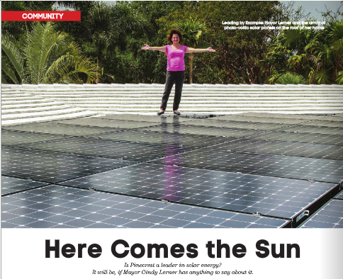

Slide 40
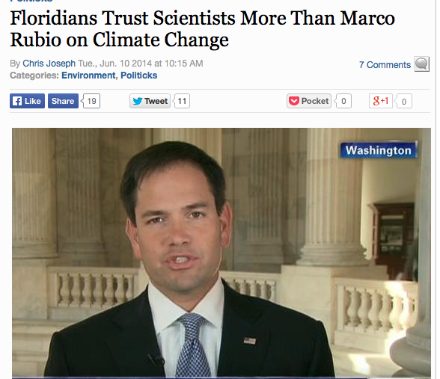

Slide 41
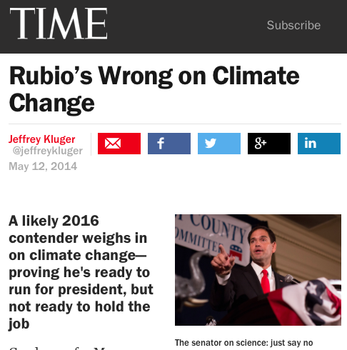

Slide 42
