Slide 1
“Implementing the Sustainable Development Goals: the Role of Cities and Regions” Presenter: Mayor Darrell Bradley Belize City

Slide 2
Overview of Presentation
(1) Overview of Local Government in Belize
(2) Role of Local Government in Development
(3) Perspective in implementing the SDG’s at the local level

Slide 3
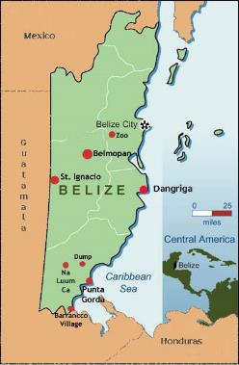
Overview of Local Government in Belize
National population is approximately 375,000 people
Roughly half of the population live in urban areas
The country has two cities: Belize City, the most populous urban area, and Belmopan, the capital, seven towns, and over two hundred villages or semi-organized rural communities
Belize is a unitary state with a central and local governments but no district government
The local government is organized as a council-manager system headed by a directly elected for three year terms and a city or town manager. The council is responsible for oversight, strategic planning and vision setting and the city or town manager is responsible for the day-to-day administration of the council
Cities and town have a legal mandate to deal with the good governance and rule of their municipality with specific responsibility for infrastructure, parks, recreation, cemeteries, sanitation, public health, markets, traffic, granting building permits, urban planning and zoning and they have involvement in tourism and local economic development
Cities and town have a fair degree of autonomy, including financial autonomy, in that they have own-source revenues made up of property taxes, trade license fees, liquor license fees, planning permit fees, traffic revenues and other small sources of direct income which are collected directly by and kept by the municipalities. Cities can also raise funding for capital projects through borrowing and issuing debentures or loans or bonds or creating private public companies and they also receive a cash transfer from the central government (for Belize City the cash transfer represents 6% of the annual revenue requirement)

Slide 4
Role of Local Government in Achieving SDGs
Local government can and should play a powerful role in achieving development goals but local government needs greater autonomy to carry out its function
Local government is that arm of government closest to the people and more in tune with community needs and in this sense is more relatable
Local government also tends to be more responsive and specific, dealing with projects that alleviate immediate problems, rather than being tied up in policy discussions
It is not that local government wants to be independent, it cannot be, but the idea is that certain functions of government can better be carried out at the local level, and so local government must be given the necessary powers to be a complimentary and supporting arm of government for the achievement of national development goals
This calls for a change in how local government is seen by all arms of government and by the community and a change in how local government approaches decision making and embraces its function as a vehicle for national development
For local government to take its place central governments need a policy of decentralization
Local government also must focus on capacity building

Slide 12
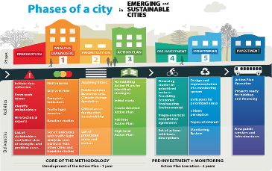
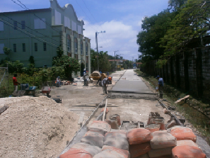
Trade License Act

